Slide 1
Research Policies and Procedures
of the Navajo Nation Human Research Review Board (NNHRRB)
http://www.nnhrrb.gov
928-871-6929
928-871-6255 (fax)

Slide 2
“Indigenous people and researchers: building collaborative partnerships and the importance of responsibilities, ethics, and values of research on the Navajo Nation”
NAVAJO NATION HUMAN RESEARCH REVIEW BOARD

Slide 4
NAVAJO NATION HUMAN RESEARCH
REVIEW BOARD MEMBERS
(Navajo Nation IRB Federal Wide Assurance (FWA) # IRB00000641, I.H.S. #8) Expires 5-26-2027
For Protection of Human Subjects for Institutions. DHHS
Dr. Rebecca Izzo-Manymules, Ph.D., Chairperson-HHSC
Dr. Sonya Shin, MD - OPVP
Dr. Nanibaa’ Garrison, Ph.D. - OPVP
Delvin Yazzie, MPH - OPVP
Dr. Kalvin White, Ph.D.- HHSC/DoDE
Dr. David Begay, Ph.D. – HHSC
Dr. Paul Charlton, MD – NAIHS
Dr. Christopher Jentoft, MD – NAIHS
Dr. Paula R. Mora, MD - NAIHS
Staff Member – Mike Winney, IRB Coordinator
MISSION STATEMENT
The mission of the Navajo Nation Research Program is to support research that promotes and enhances the interests and the visions of the Navajo people; to encourage a mutual and beneficial partnership between the Navajo people and Researchers; and to create an interface where difference cultures, lifestyles, disciplines, and ideologies can come together in a way that improves, promotes, and strengthens the health of the Navajo people.

Slide 5
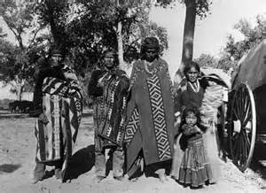
Presentation Objectives
History and Development of the Navajo Nation Human Research Review Board
Research Protocol Application Process
Navajo Nation Standards of Approval
Stages in the review and approval process
12-phase NNHRRB review and approval process

Slide 6
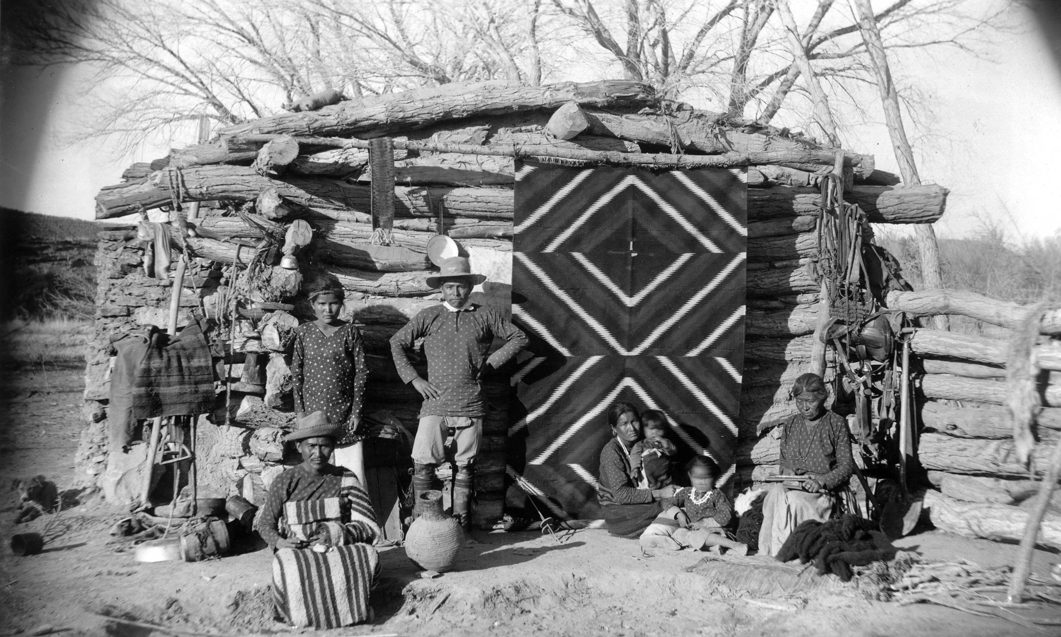
I. Introduction
Following is description of NNHRRB policies & procedures
Developed in 1996 and revised in 2002, due to increased requests
Tribal research policies & protocols derived from ethical principles and legal protections inherent in rights of indigenous nations
Notes:
Gave talk on CBPR Scotsdale: First Community IRB 1995 HRSA SPNS project How NN IRB was the only way to do research in this
Environment. Beverly said the NN IRB needs to get its stuff out there
NCMHD came along - used as opportunity to get articles written - Beverly, Kalvin, IRB Members, Lynn Holder, Sherick Roanhorse, Nathania Tsosie

Slide 7
2. History & Development of the Navajo Nation Human Research Review Board
Navajo people possessed indigenous knowledge & science for over 1000 years
Most researchers are non-Indians
NNHRRB ASSETS / STRENGTHS
NNHRRB meetings are held monthly and on a consistent basis. Dedicated group of 9 professional committee members monitoring 220 open studies and with 1770 closed studies in arhives.
NNHRRB has National and International reputation as a leader of tribal IRBs.
Has established relationship with academic institutions such as Johns Hopkins, U of A, UNM, U of Utah, ASU, NAU, Diné College, NTU, etc.
Hold bi-annual NNIRB Research Conference in Window Rock in order to share research findings with all.

Slide 8
Enabling Legislative
The Navajo Nation Human Research Review Board was developed in1996 to guarantee ethical research for the Dine´ People.
Purpose: The purpose of this Code shall be to set forth the conditions under which investigators, physicians, researcher and other may perform health and health related research activities within the territorial jurisdiction of the Navajo Nation;
Policy: It is the policy for the Navajo Nation to ensure that all persons within the territorial jurisdiction of the Navajo Nation are free from unreasonably harmful, intrusive ill-conceived or otherwise offensive research and investigation procedures.
Navajo Nation Council 13.N.N.C. §3253 Health and Welfare
Chapter 25. Navajo Nation Human Research Code (section 3251 – 3271)
October 25, 1995, CO-106-95
April 16, 2002, CAP-16-02 (Revised)
National I.H.S. IRB Navajo Nation Human Research Review Board(and Navajo Area I.H.S. IRB)
Certification #IRB00000641

Slide 9
BELMONT REPORT Ethical Principles and Guidelines for Research Involving Human Subjects
Beneficence
Do No Harm
Maximize possible benefits, and Minimize possible harm
Navajo Nation
Person
Community
Justice
“fairness in distribution”
each person an equal share, according to individual need, effort, societal contribution, and to merit.
Respect
Protection
Individuals should be treated as autonomous agents, and persons with diminished autonomy are entitled to protection

Slide 10
1987 “Belmont Report”
Prompts IHS to establish IRB committee
In 1979 IHS forms Navajo Area IHS IRB
Navajo Nation responds through self-governance
In 1992, the Navajo Nation operationalized the NAIHS IRB;
1995: Navajo Nation Council enacts Navajo Nation Health Research Code CO-106-95
1996: NNHRRB began reviewing study proposals (Navajo Nation IRB Federal Wide Assurance (FWA) # IRB00000641, I.H.S. #8) For Protection of Human Subjects for Institutions. U.S. Department of Health &Human Services
2002: Navajo Nation Council expanded NNHRRB authority by adopting resolution IGRJN-86-02 to review, monitor & approve research

Slide 11
15 NNHRRB Members
3 persons appointed by the Navajo Area Health Board
3 persons appointed by the Office of the Navajo Nation President
3 persons appointed by the Navajo Nation Council Health and Social Services Committee
3 persons appointed by the Navajo Nation Council Education Committee
3 persons appointed by the Navajo Area Indian Health Services Director

Slide 12
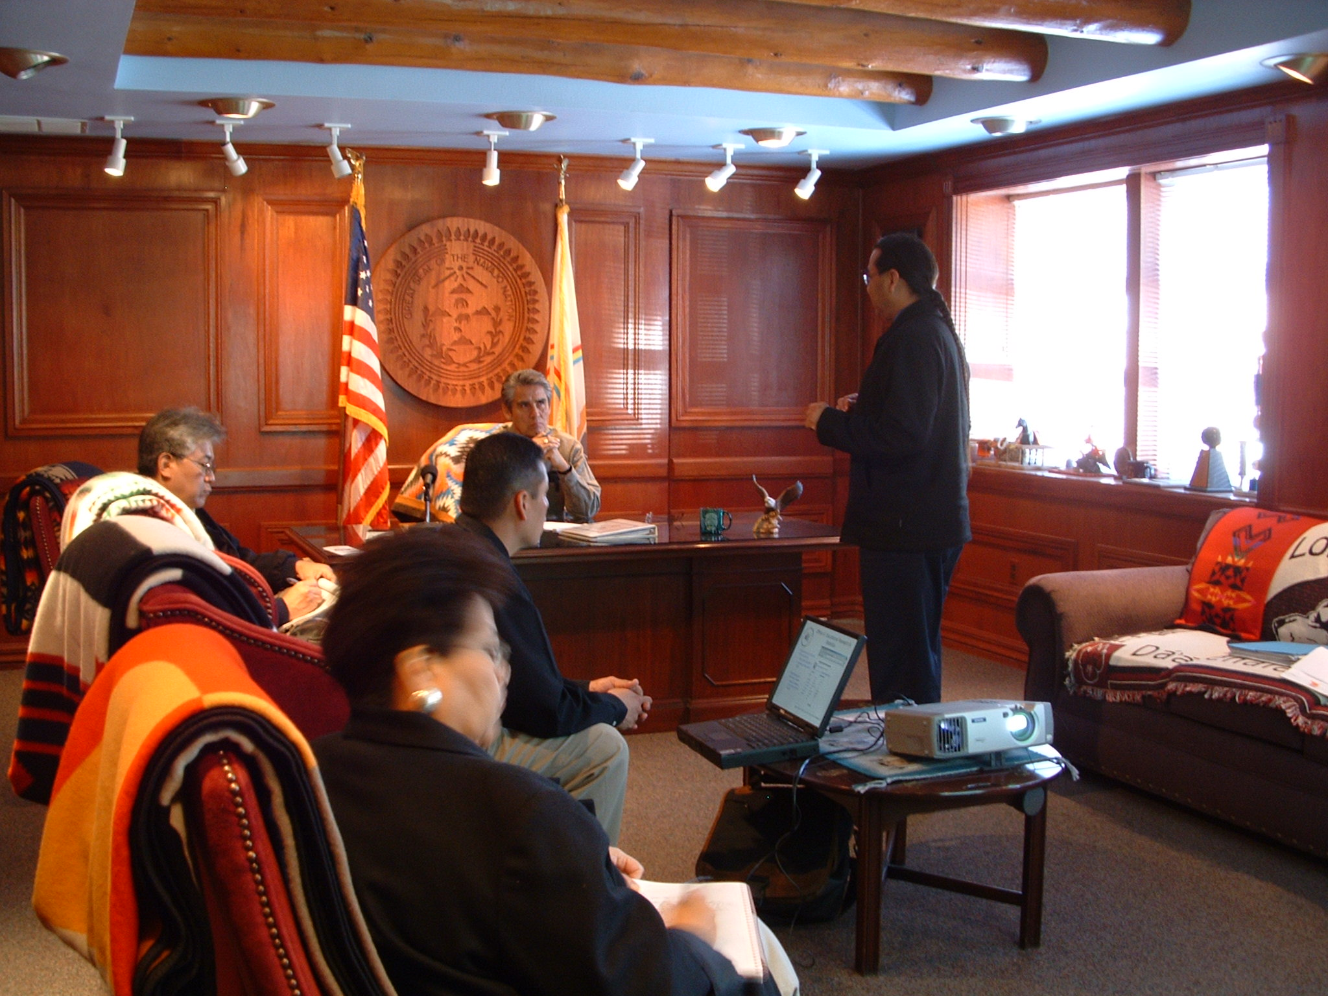
99999999

Slide 13
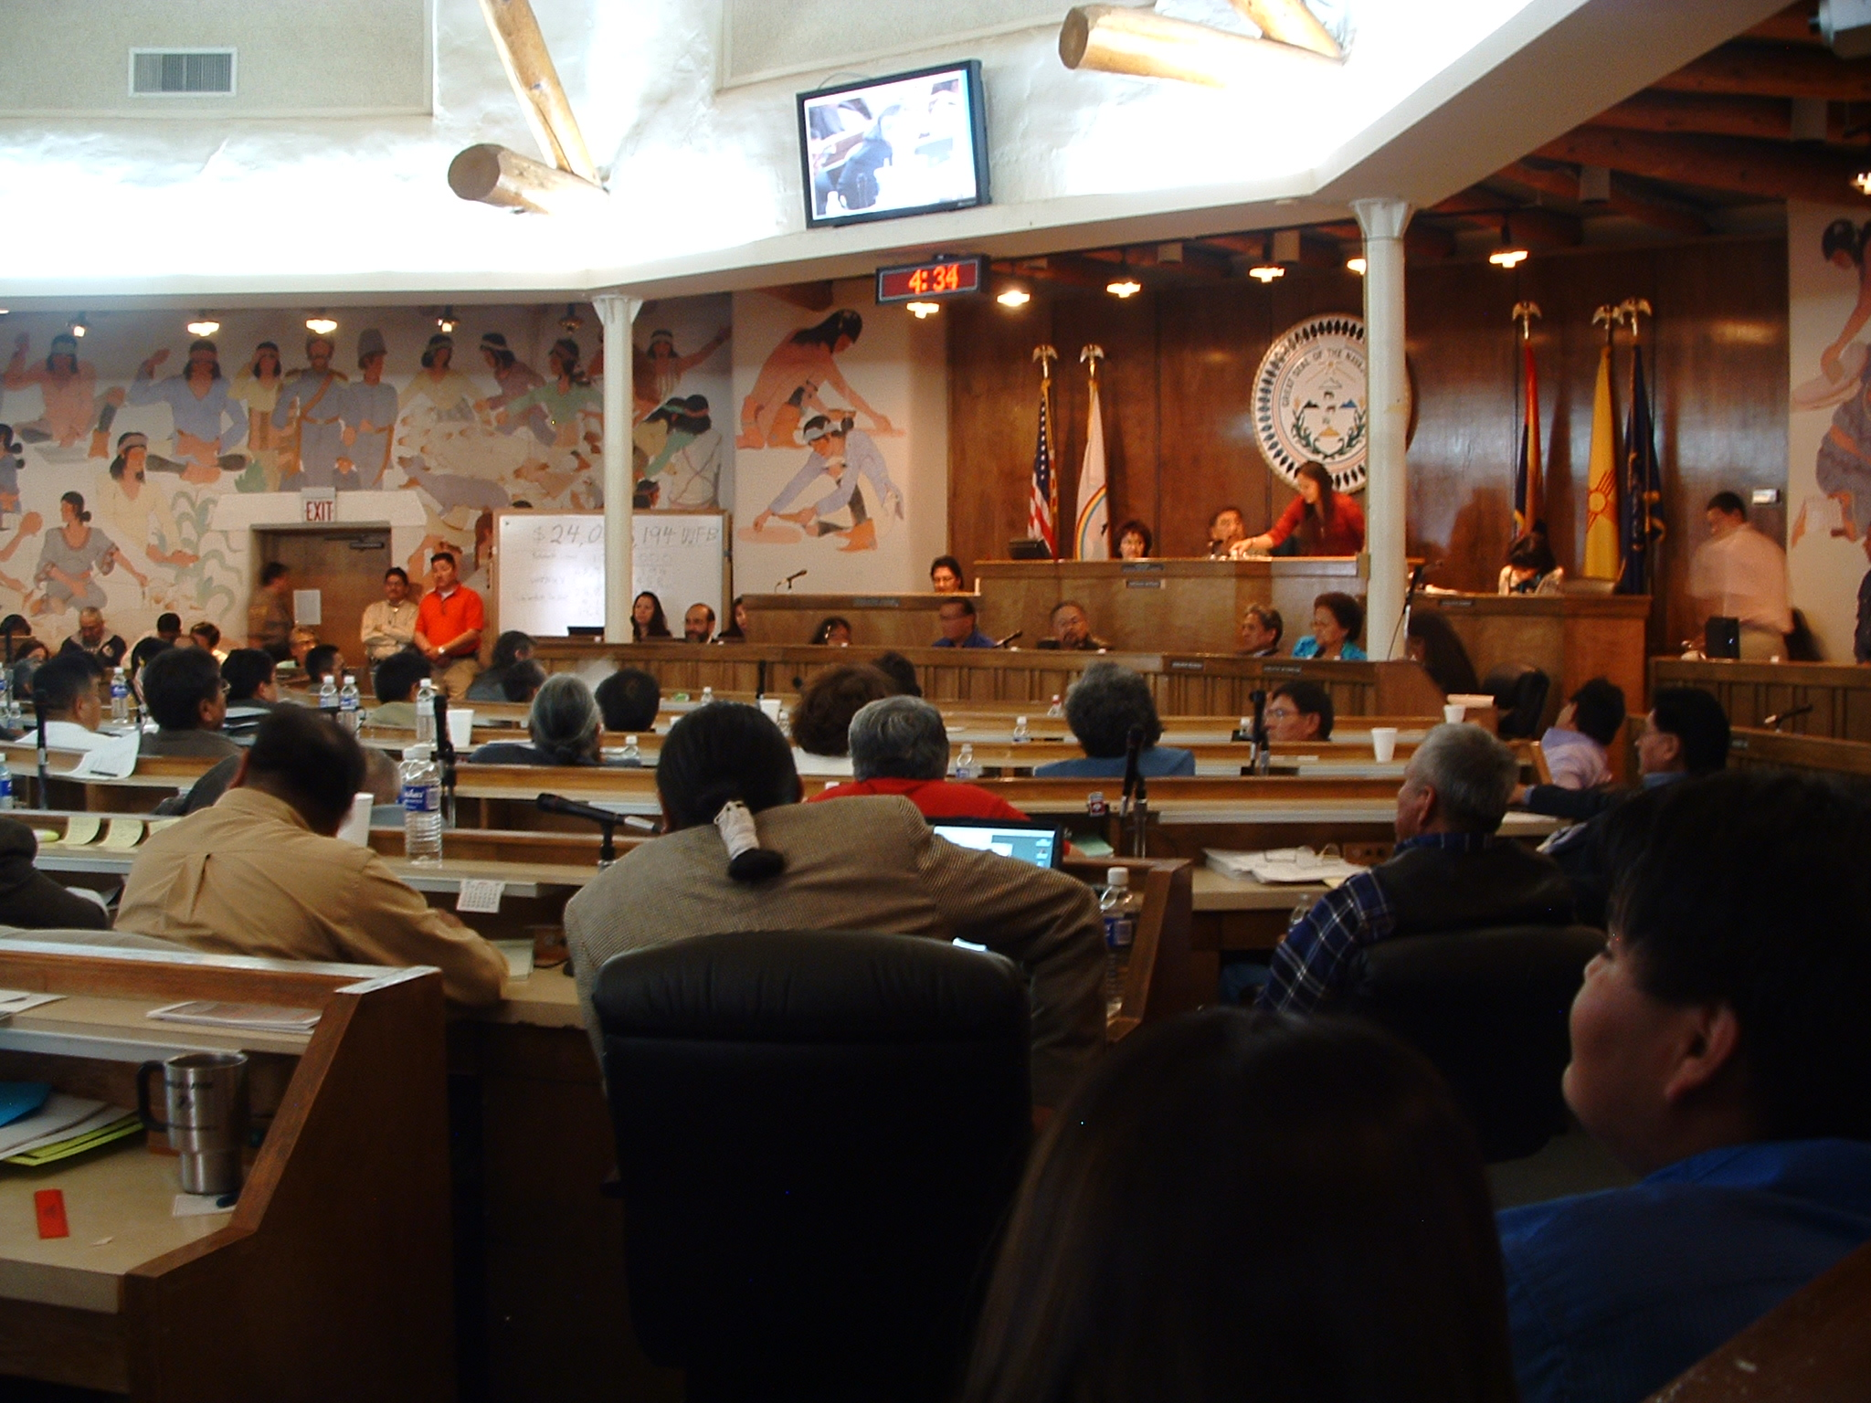

Slide 14
Research Protocol Application Process
PI submits application to HRRB two months prior to in-person presentation
Application must include the following:
CEO support letters from NAIHS Service Units & NN Program Directors
permission from affected NN offices/agencies
study-specific documents
detailed budget
two approving resolutions from agency councils, chapters or IHS units

Slide 15
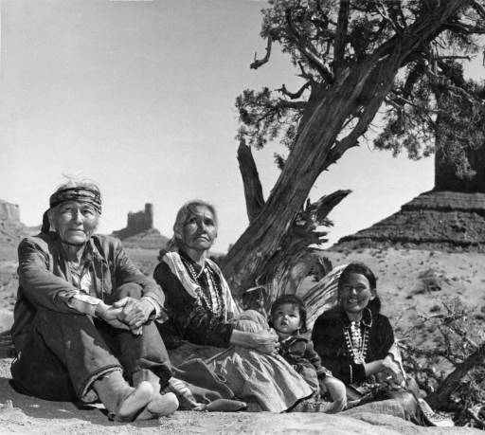
Navajo Nation Standards of Approval
Community involvement
Benefits to the Navajo Nation
Authority of the Navajo Nation
Research project description
Informed consent form
Certification by the Principal Investigator

Slide 16
Twelve-phase NNHRRB review and approval process
Phases I – III: Involvement & Participation Phases
I Community Partnership
II Tribal Program Partnership
III Screening of Research Application
Phase IV: Meeting and Presentation
IV NNHRRB Decision-making phase
Approve
Amend
Disapprove
Phases V – VII
During phase V, if research is approved in Phase IV the PI within 30 days will receive a one year annually renewable research permit. (Quarterly and annual progress reports are required)
Involvement & Participation Phases
V Study implementation
VI Data analysis & preliminary findings
VII Data work session

Slide 17
Phases VIII – XI: Dissemination phases
VIII Final report & Dissemination plan
IX Transfer of Data to the Navajo Nation
X Manuscript publication
XI Community feedback & presentations
PI will present research results to Chapters, Schools, Health Boards and relevant tribal programs)
Phase XII: Data transfer phase
XII Final transfer of data to the Navajo Nation
At the end of the Research Project, all data shall be given to the Navajo Nation Data Resource Center. (Intellectual & Cultural Property owned by the Navajo Nation)

Slide 18
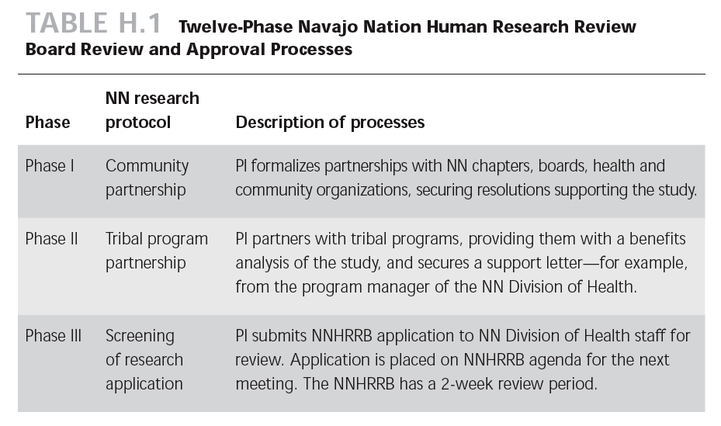

Slide 19
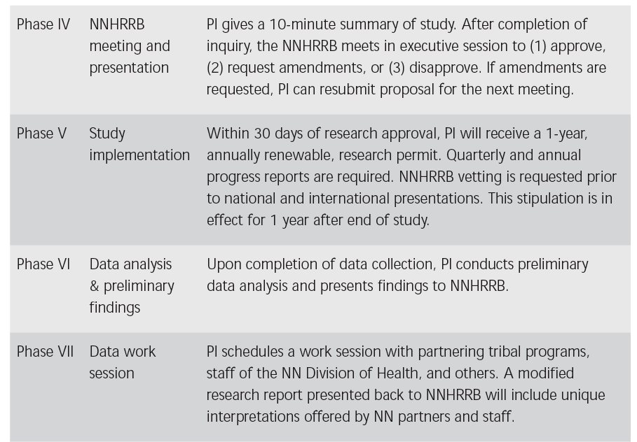

Slide 20
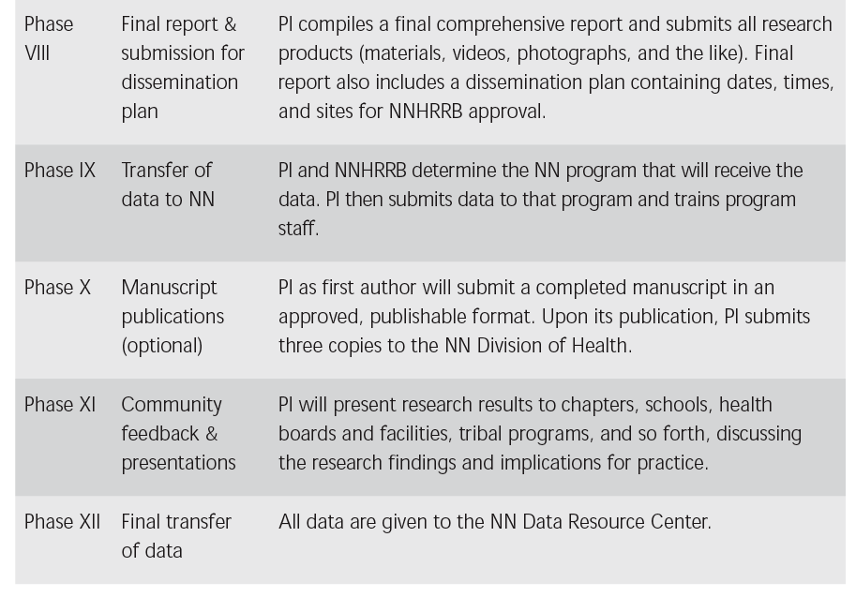

Slide 21
In Closing…
The Navajo Nation is exercising their authority bystrengthening tribal sovereignty through the complex maze of federal, federal Indian, state and tribal policies to reclaim and protect intellectual & cultural rights of their people and future generations. The NNHRRB research processes and protocols demonstrate steps toward effective partnerships and improved relationships between community and researchers as we all work together to improve health outcomes for American Indian people.

Slide 22
Navajo Nation Human Research Review Board Promote “Expert Indians instead of Indian Experts” Quote from NNHRRB Chair, Ms. Beverly Pigman, (June 27, 2006)

Slide 23
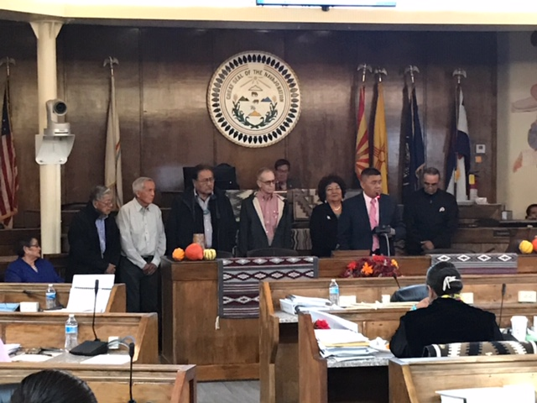
NNHRRB Members get Recognition and Meritorious Service Award from Navajo Nation Council on 10-16-18.

Slide 24
Contact:
Dr. Rebecca Izzo-Manymules, Chair Mike Winney, IRB Coordinator
Navajo Nation Human Research Review Board Navajo Department of Health
rizzonnirb@gmail.com mrwinney@navajo-nsn.gov
(928) 871-6929 (928) 871-6929 / 6350
(928) 871-6255

